Slide 1

Planet Alcatraz
Gloria Abromeit, Kanwal Bhatia, Amrrita Sethi, Janet Garcia & Omer Kleiner

Slide 2
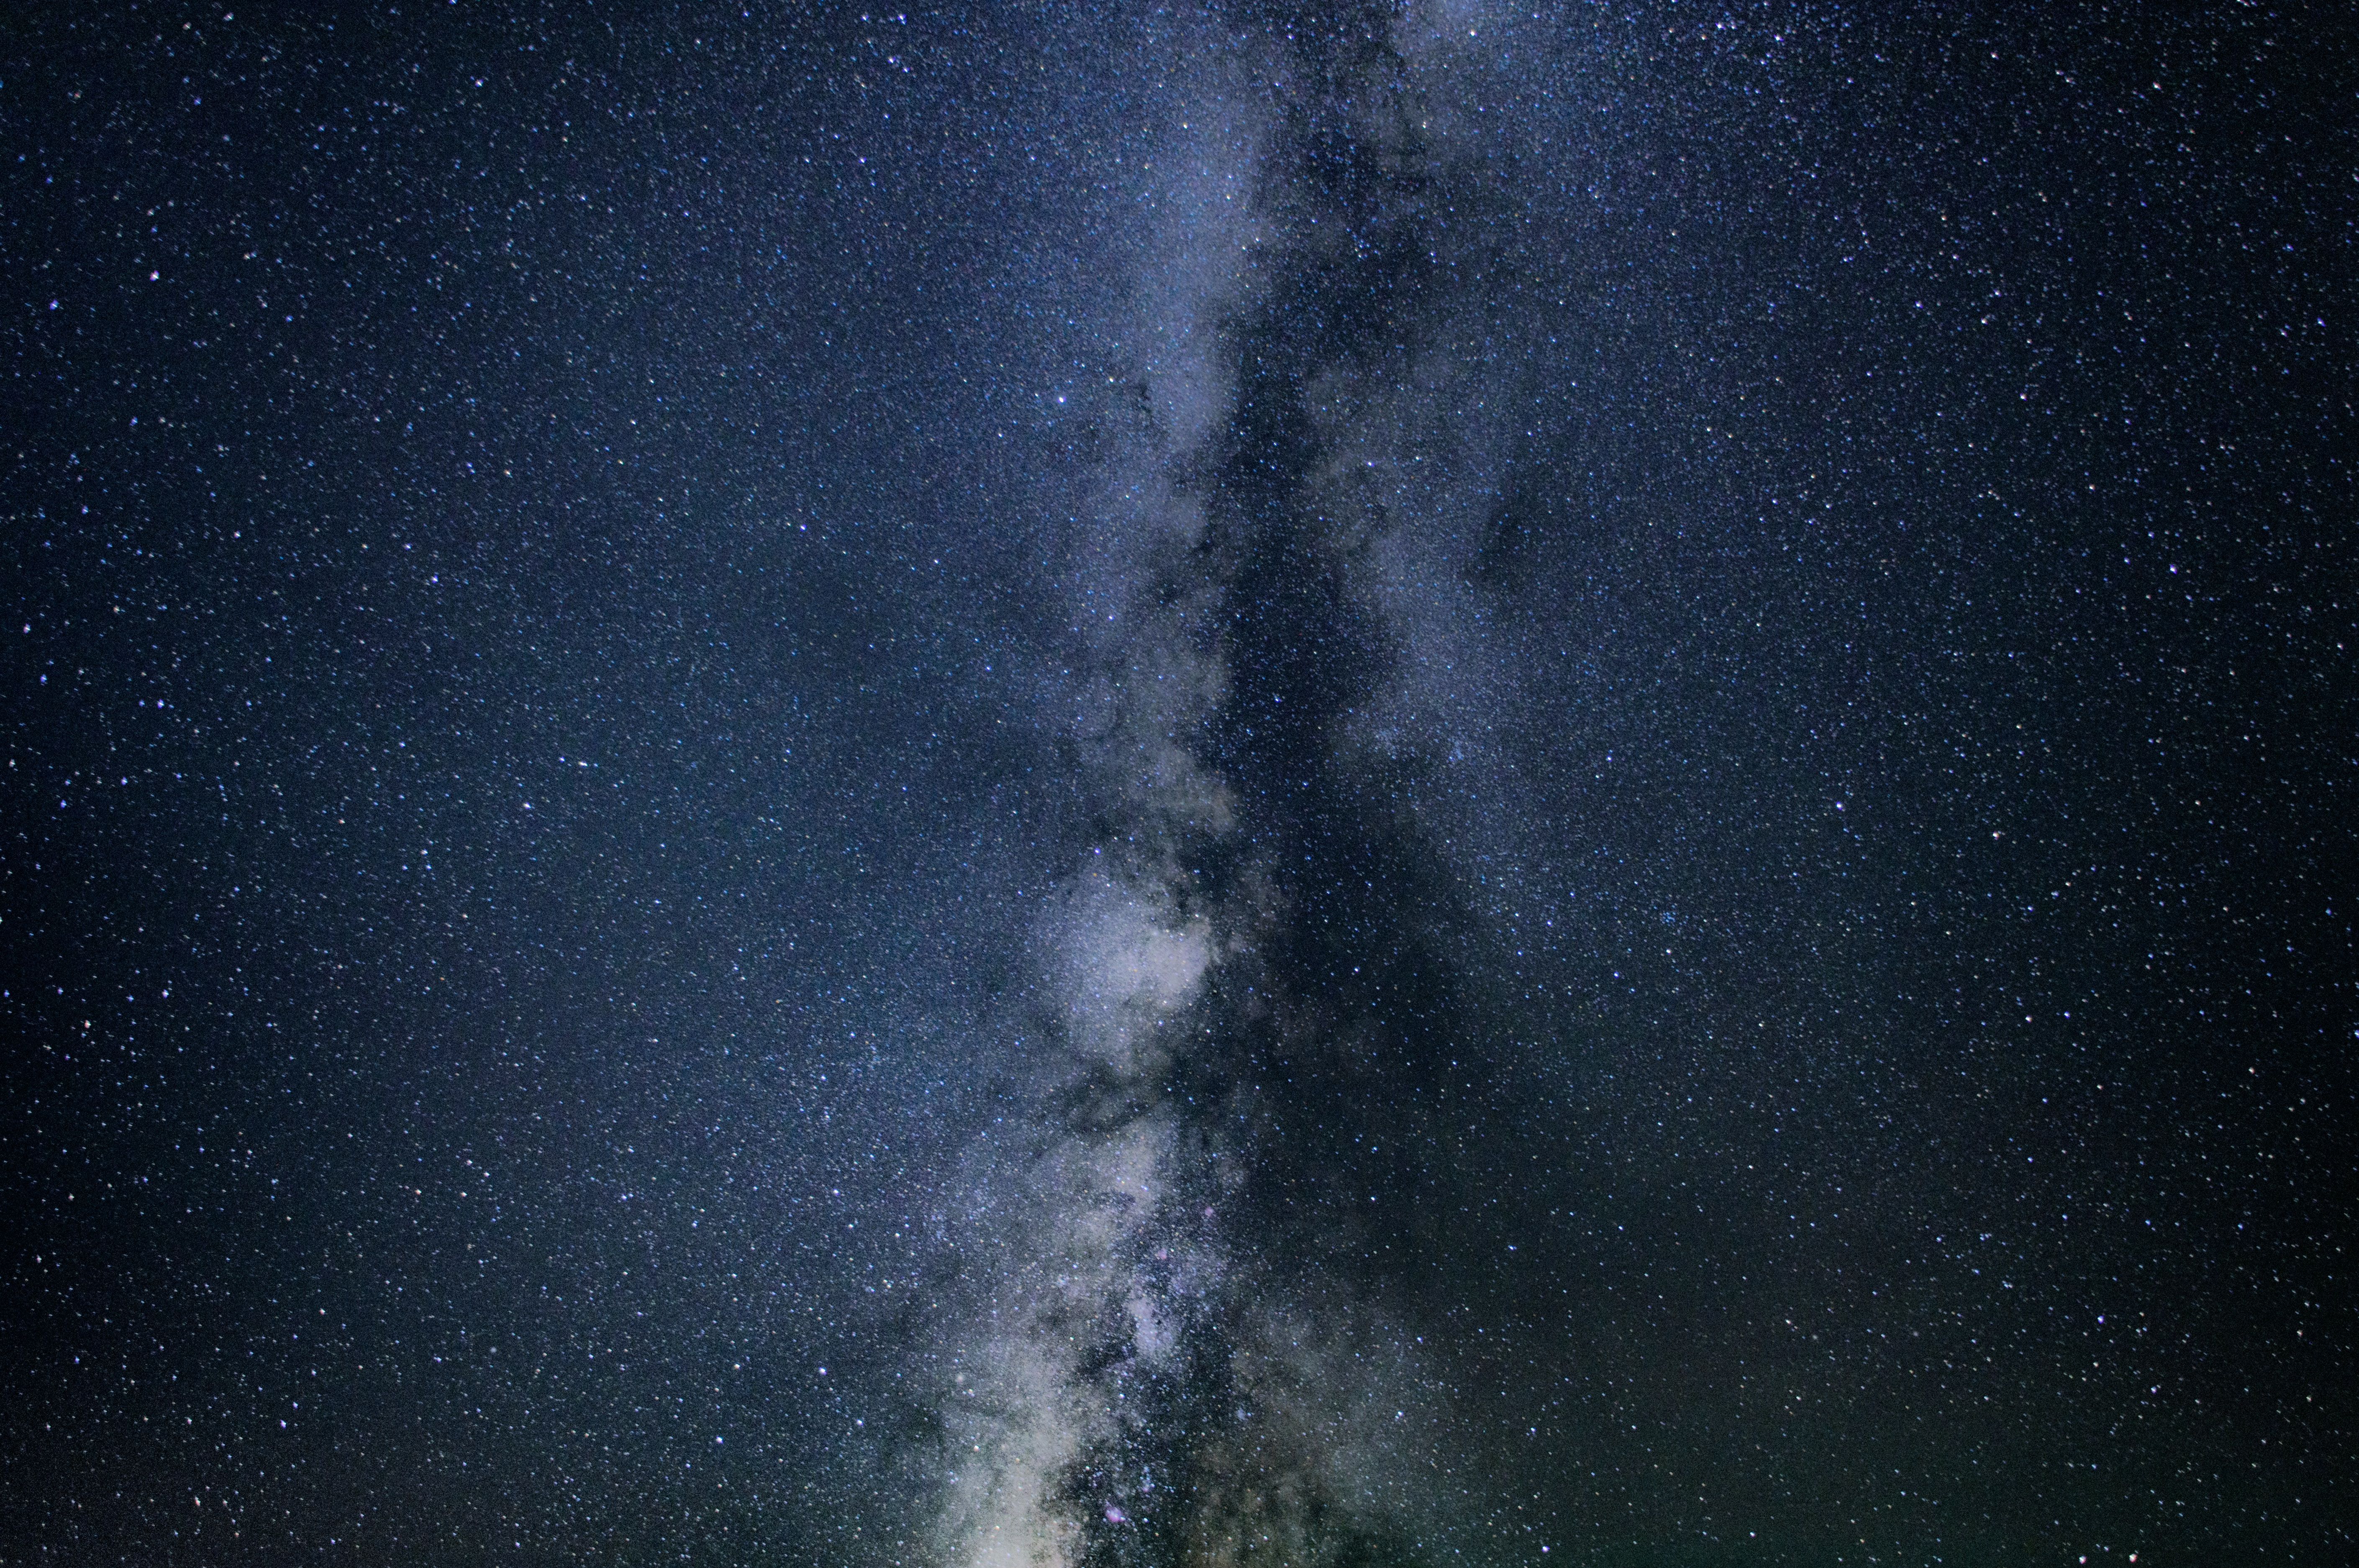
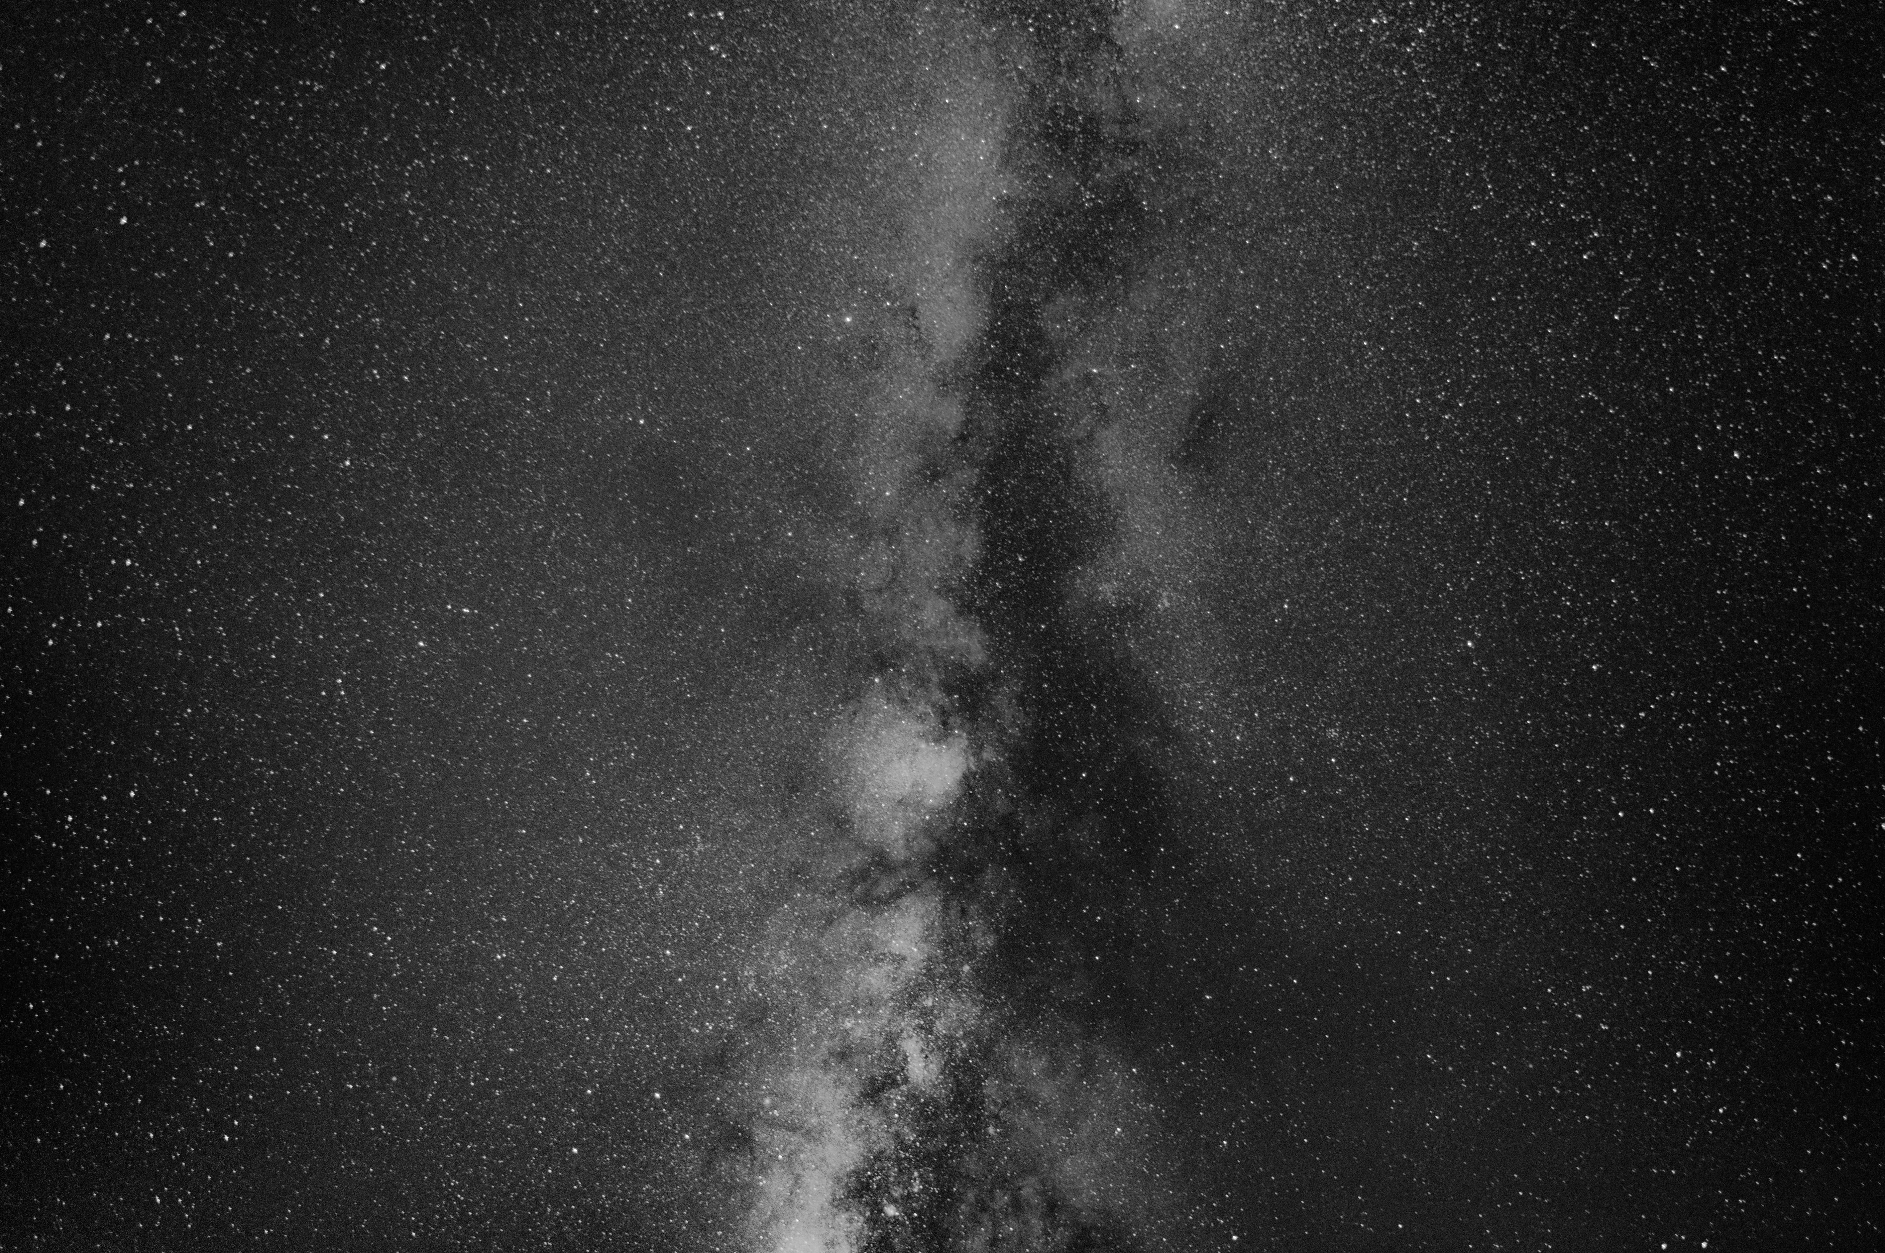
Hypothesis
If UFO’s are airplanes then there should be a correlation between UFO sightings and flight activity.
Null Hypothesis
If UFO’s are not airplanes then there should be no correlation between UFO sightings and flight activity.
Planet Alcatraz

Slide 3

To determine a relationship, we had 3 sub-questions to explore:
Does the proximity to airports influence the number of UFO sightings?
Does local flight traffic contribute to the number of UFO sightings?
Does the change in flight traffic over time influence the number of UFO sightings over
the same period?
Planet Alcatraz

Slide 4
Data used to answer questions:
Airport Departure Statistics (API) Statistics on scheduled commercial departures and connections by airport since 2003
The UFO API is a collection of UFO Sightings. The original dataset comes from The National UFO Reporting Center. The data has been modified and augmented with location data to allow location based searches. Note that the returned location data is in longitude and latitude format.
Google Maps (API) Used to get latitudes, longitudes and names of airports
Planet Alcatraz

Slide 5
Data Clean-up and Exploration
Exploration:
Initial topic: an exploration of UFO’s and blood alcohol content or sales
Finding alcohol data proved to be a challenge
Explored UFO’s and airplane data, more easily available
Clean-up:
Cleaned-up UFO Data (UFO API)
Found closest airports to the UFO sightings (Google API)
Gathered and cleaned-up Airport Data (Airport API)
Planet Alcatraz

Slide 6
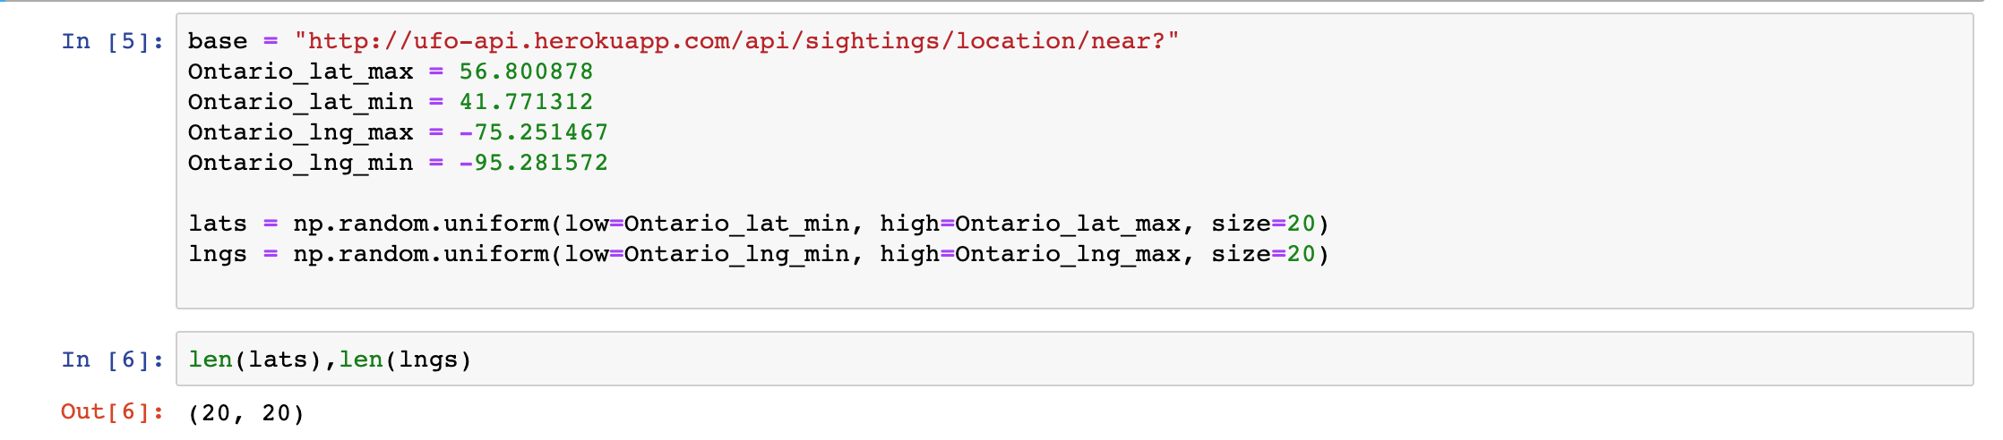
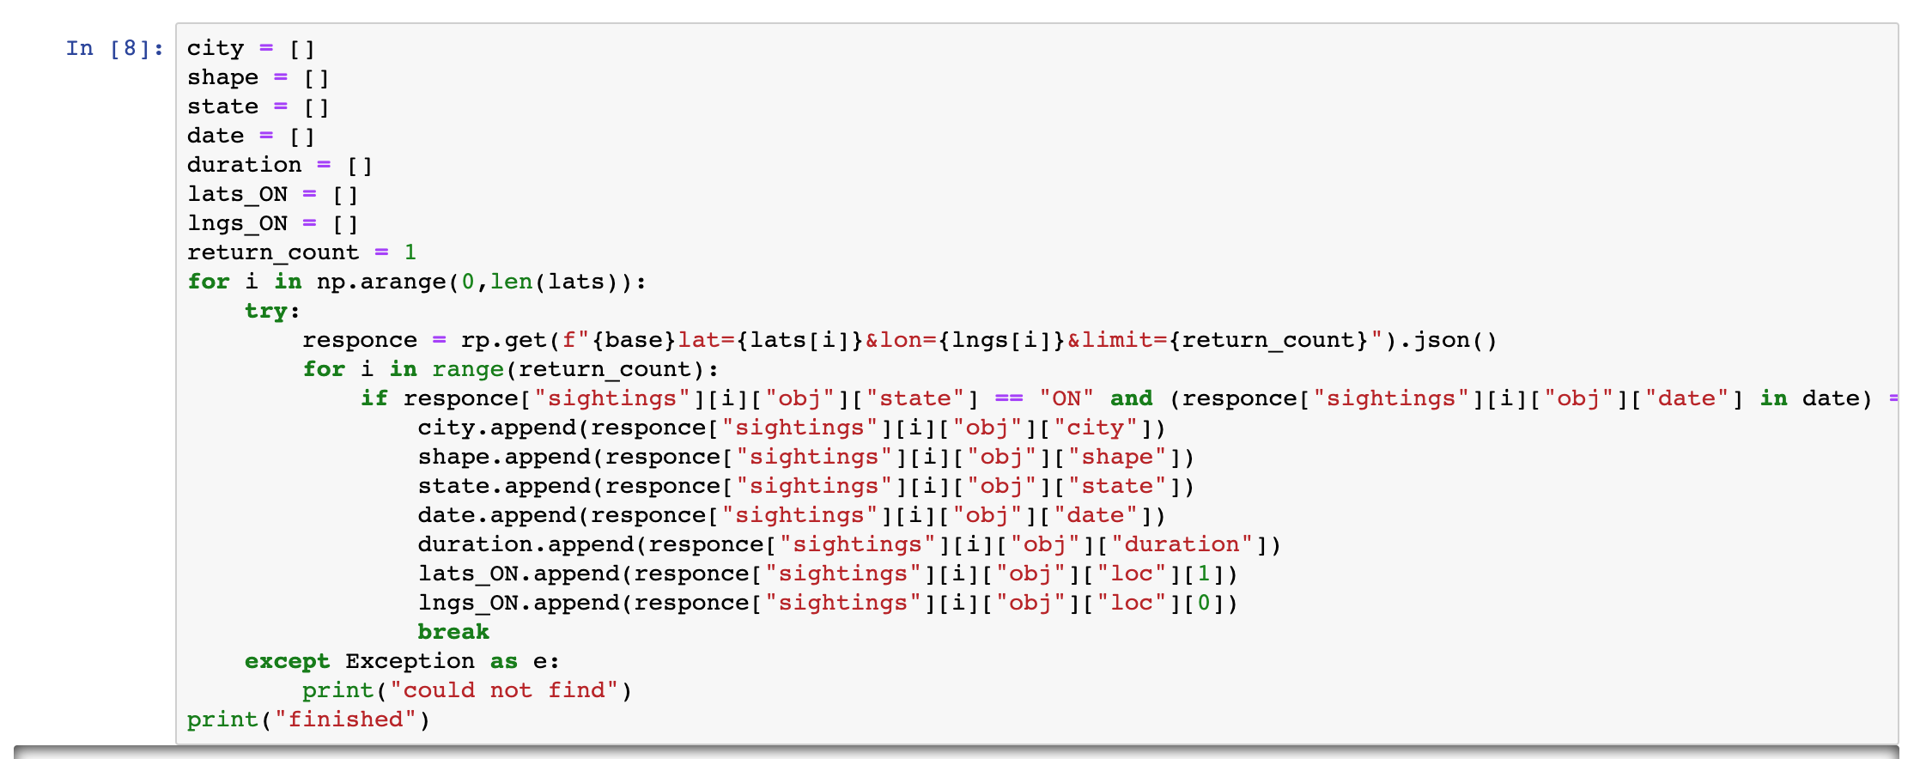
Data Clean-up and Exploration / Cleaning up the UFO Data
Planet Alcatraz

Slide 7
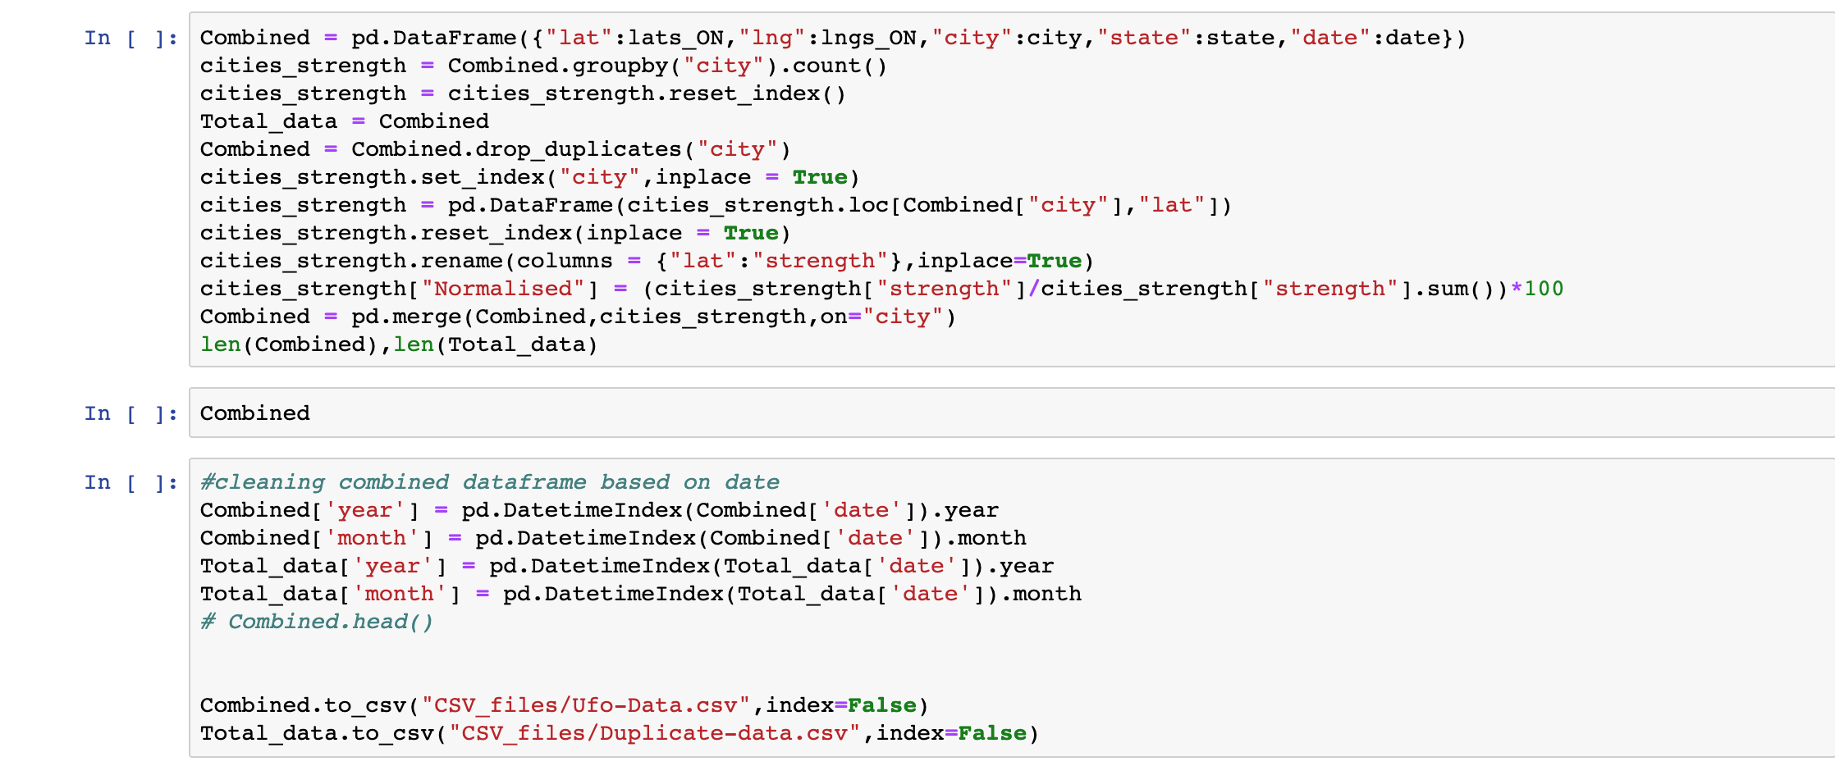
Data Clean-up and Exploration / Cleaning up the UFO Data
Planet Alcatraz

Slide 8
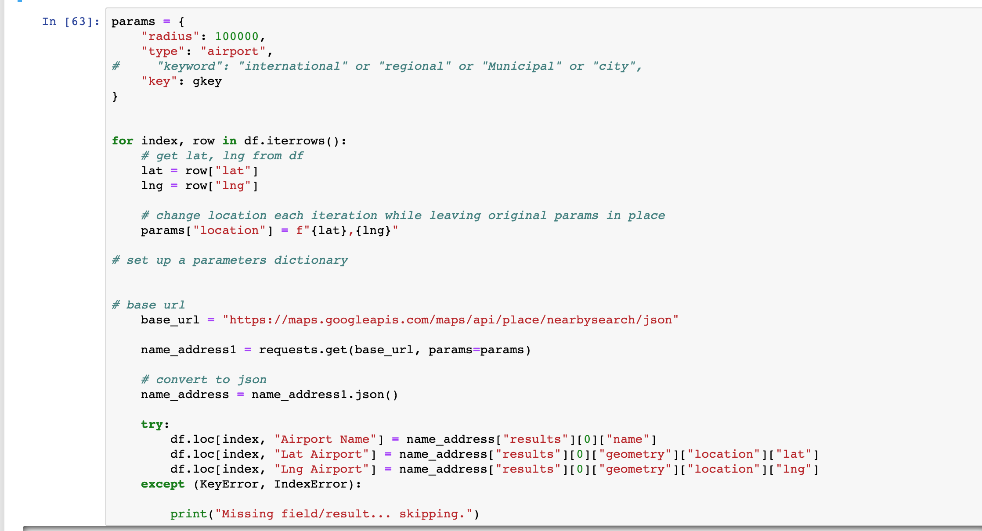
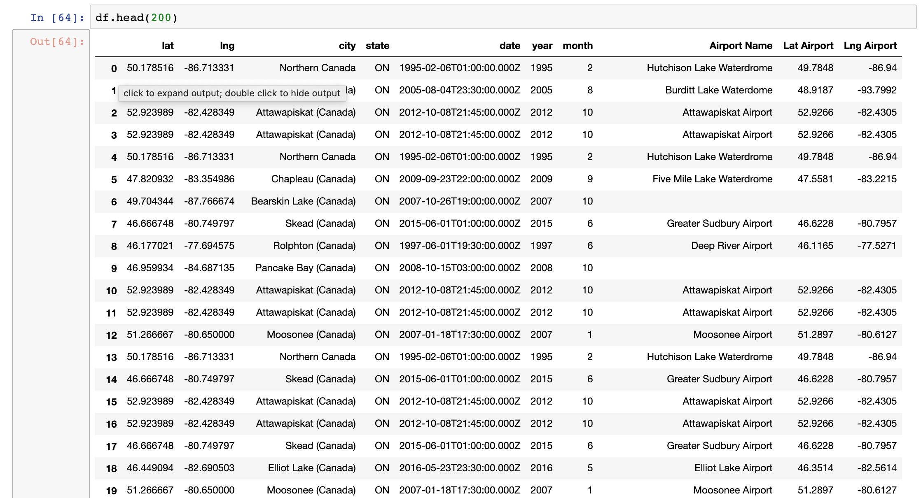
Data Clean-up and Exploration / Finding the Closest Airports
Planet Alcatraz

Slide 9
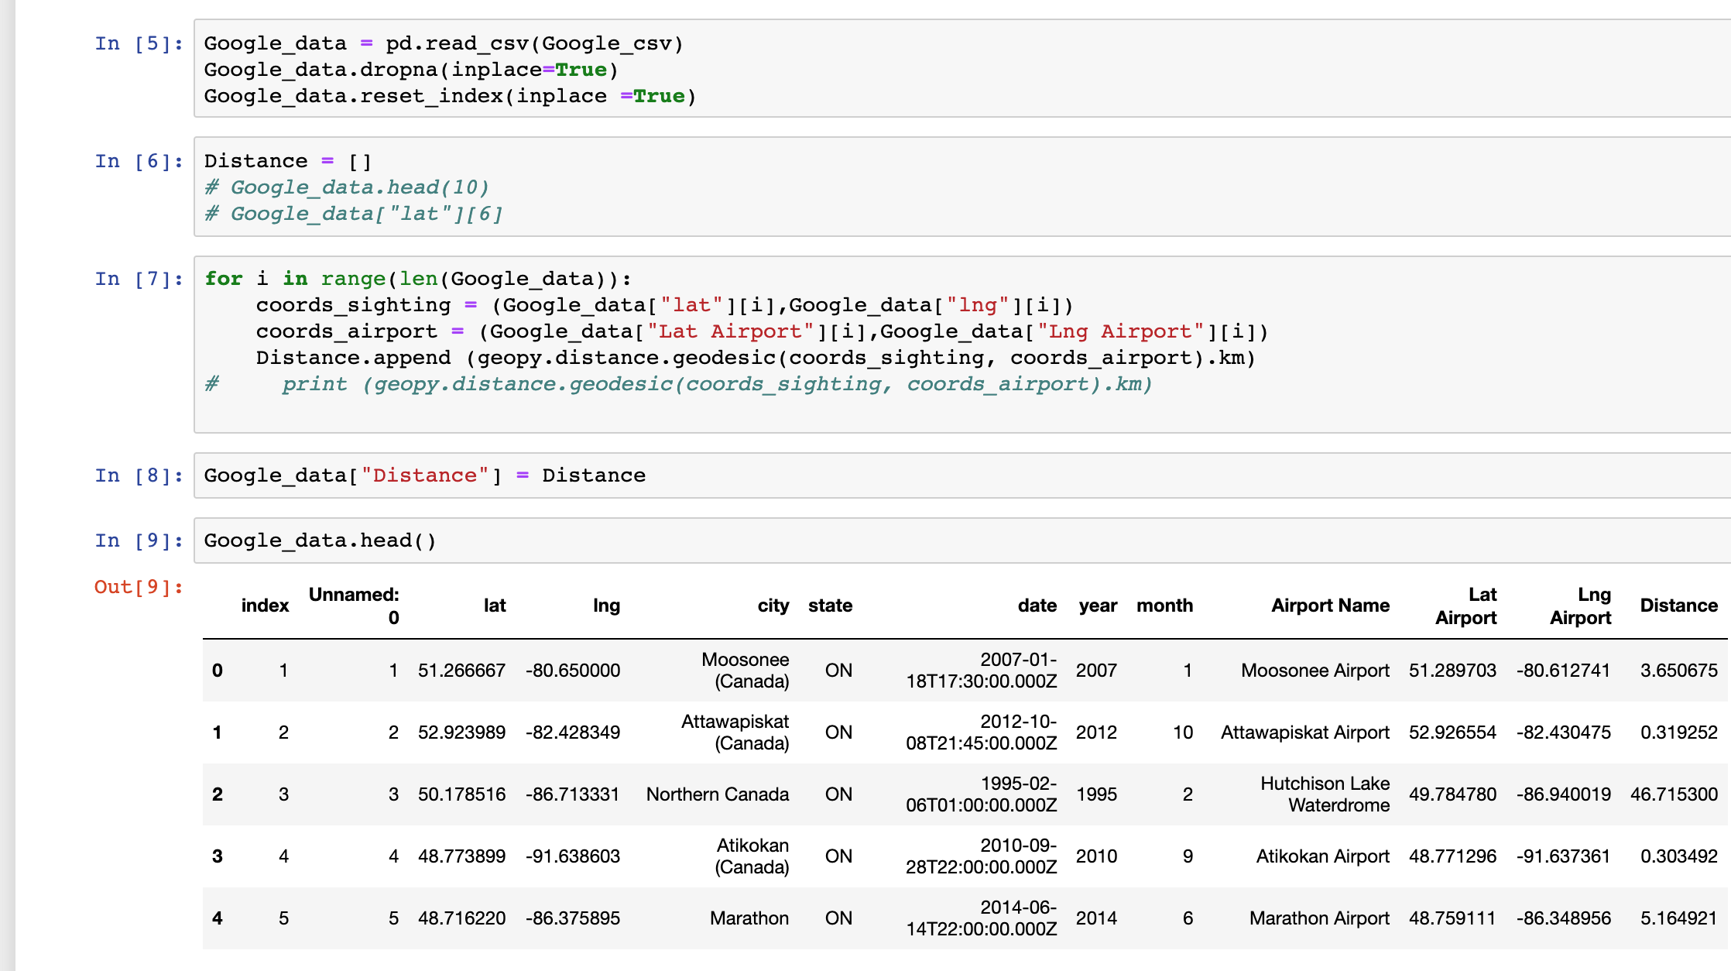
Data Clean-up and Exploration / Finding the Distance
Planet Alcatraz

Slide 10
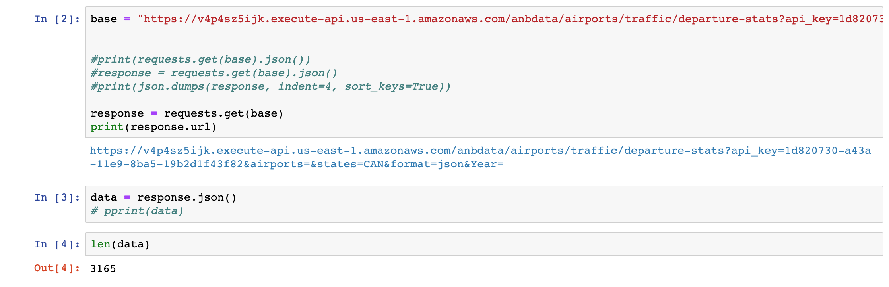
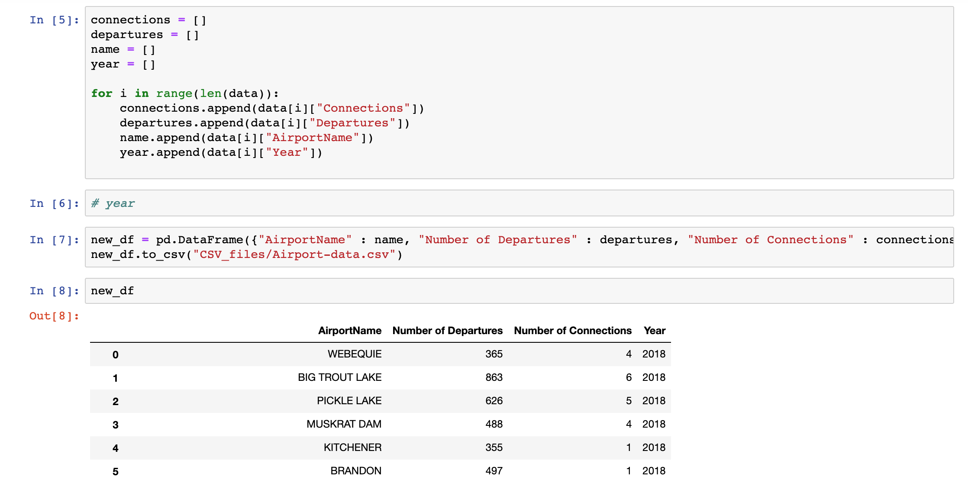
Data Clean-up and Exploration / Gathering Airport Data
Planet Alcatraz

Slide 11
Problems with Data Clean-up
Extracted UFO data for Ontario based on latitude and longitude, to later realize that there we several duplicates of each sighting. To resolve this, we filtered the UFO data by Ontario AND unique dates
Being unable to merge the UFO and airport data sets on year because the airport names were inconsistent in 2 datasets.
Planet Alcatraz

Slide 12
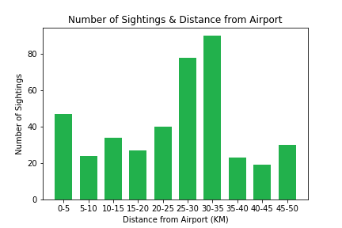
Does the proximity to airports influence the number of UFO sightings?
Most sightings were 25-35 KM away from an airport
Could be just “far enough” to think an airplane looks like a UFO
Significant amount also in the 0-5 KM range
Planet Alcatraz

Slide 13
Does the proximity to airports influence the number of UFO sightings?

Slide 14
Does local flight traffic contribute to the number of UFO sightings?

Slide 15
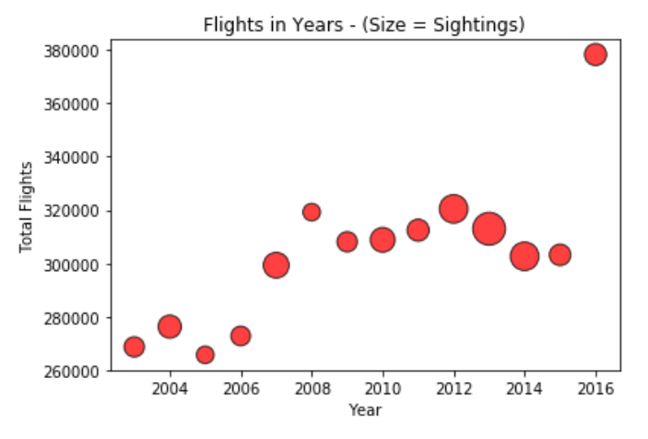
Does the change in flight traffic over time influence the number of UFO sightings over the same period?
Volume of flights rose over the years in Ontario
Sharp increase in 2016
No obvious pattern between sightings and flights
Planet Alcatraz
Notes:
The volume of flights, both departures and connections, in Ontario steadily rose over the years covered in this analysis.
A sharp increase was registered in 2016, the period when the number of sightings was noticeably low.
- There is neither an increase pattern nor a decrease pattern in the level of reported sightings from 2004 to 2016. There is no consistency to the number of sightings over the years. It reached its peak in 2013, when the number of flights recorded a modest decline from the previous year.
- Except for the period between 2005 and 2006 when both flights and sightings reached a low level, there was no evident agreement in terms of the trends that flights and sightings recorded over the years.

Slide 16
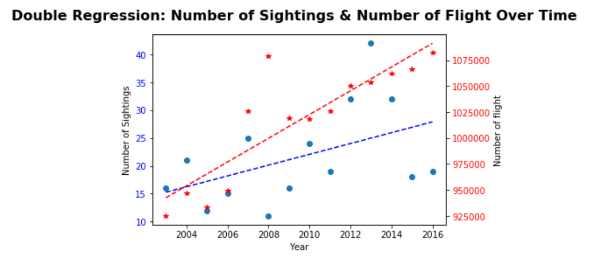
Does the change in flight traffic over time influence the number of UFO sightings over the same period?
Slight increase in UFO sightings over time
( p-values = 0.0928)
Significant increase in flight departures over time
(p-value = 7.5 x 10⁻⁵)
No obvious correlation
Planet Alcatraz

Slide 17
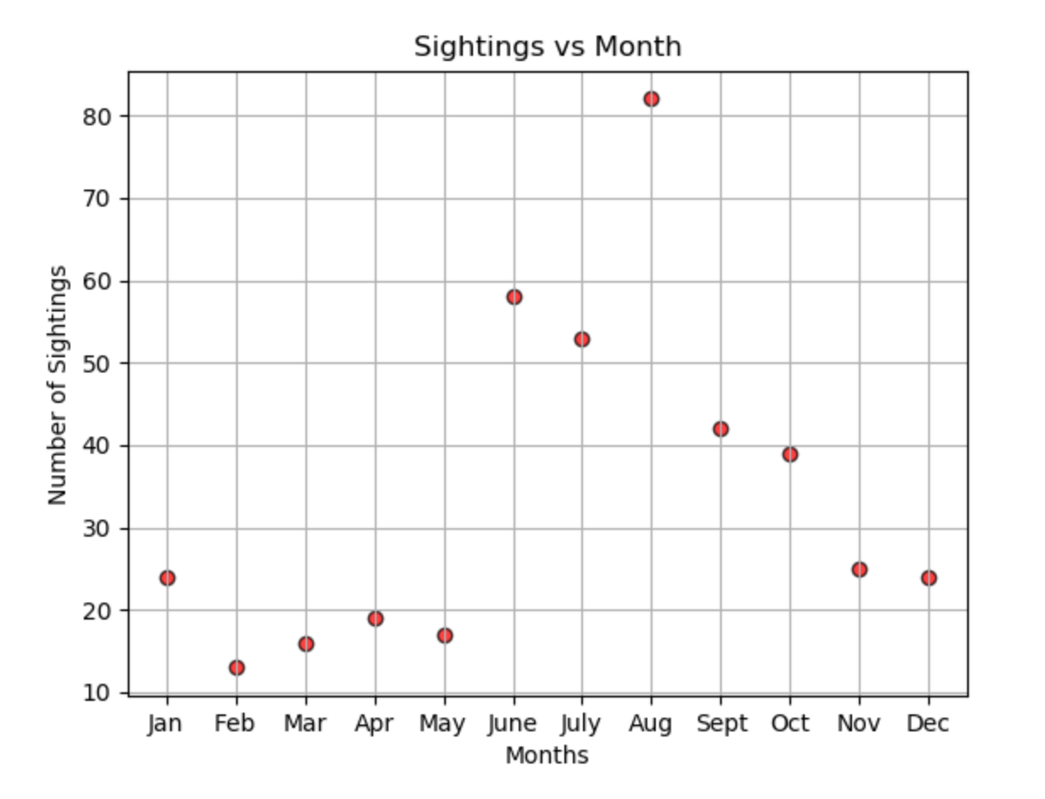
Conclusion
Mixed results, no absolute clear correlation between airplanes and UFO sightings. Unidentified Flying Objects will indeed stay unidentified!
If we had more time to research, we would:
Research populations densities,
Compare with weather conditions,
Compare with alcohol consumption,
Time of year/week,
Human behavior,
Broaden the scope from just Ontario to the world
Planet Alcatraz
Notes:
The unknown and intriguing nature of UFO’s brings with it lots of different variables to consider. And this was visible in our discussions. If we had 2 additional weeks, we would research:
The weather.
Our data allowed us to briefly map out the count of sightings against months.

Slide 18
References
1) https://www.icao.int/safety/iStars/Pages/API-Data-Service.aspx
Airport Departure Statistics - Statistics on scheduled commercial departures and connections by airport since 2003
2) http://ufo-api.herokuapp.com/api#home
The UFO API is a collection of UFO Sightings served through an API.
The original dataset is coming from The National UFO Reporting Center. The data has been modified and augmented with location data, to allow location based searches. Note that the returned location data is in (lon, lat) format.
3)Google maps API
Used to get latitudes, longitudes and names of Airports
Planet Alcatraz

